Slide 1
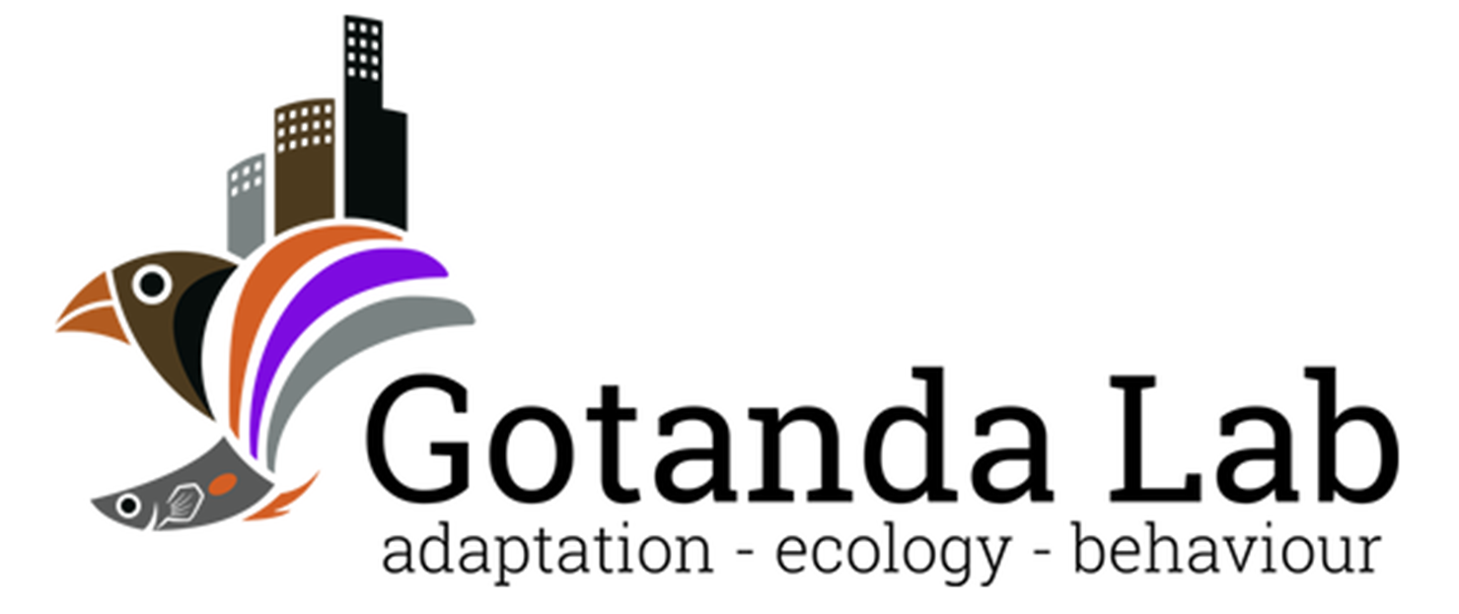

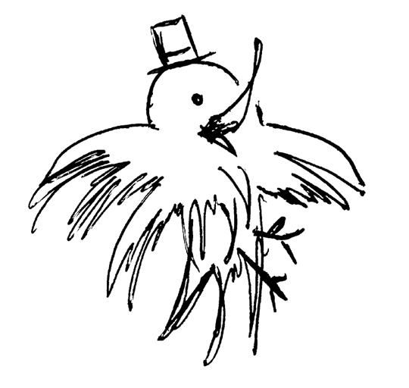
Sentinel Behaviour and Urban Environments:
A Corvid’s Perspective
Alex Popescu
Thesis Defense -
Brock University
Notes:
Add date and

Slide 2
An important trade-off
A careful balance between two essential needs must be maintained
Eat
Not be eaten
Notes:
Why should we care?
Bring up a sentence about why this is important
Abrupt
Don’t assume anything – Explain and be explicit, repeat ad nauseam
Reminder slides to connect concepts and results together. This is a long pres. Readers need to be reminded what the questions are
Place marker or roadmap
context

Slide 3


An important trade-off
Two mutually exclusive requirements; too much of either is unfit
Foraging
Vigilance
↑ Safety
↑ Risk of starvation
↑ Satiation
↑ Risk of predation
Notes:
Darker blue, match colours

Slide 4
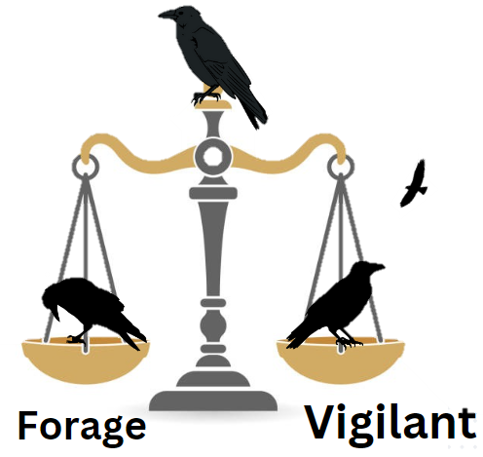
Finding the balance
A difficult task that depends on:
Intrinsic factors
Sex, Satiaton…. Etc etc
Extrinsic factors
Certain species have behaviours that facilitate this decision
Notes:
Remove the meme ☹
Add examples of factors on the slide, then hold people’s hand throughout the presentation
Add maybe a color box for each factor, then reuse throughout
Source the images

Slide 5
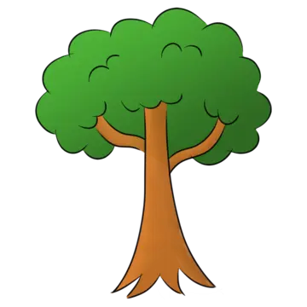

Sentinel behaviour
A form of coordinated vigilance:
- Individuals take turns being vigilant over other group members.
- Can result in increased safety and foraging efficiency in foragers.
- Sentinel loses foraging opportunities.
Lost foraging opportunity
Why do sentinels perform the behaviour if it is costly?
↑ Foraging efficiency
↓ Predation risk
Notes:
Add animations
Walk people through it
Bold or bring attention to the main points

Slide 6
Thesis objectives
Throughout my thesis, I sought to answer two big questions:
How can intrinsic and extrinsic factors affect sentinel decision-making?
How does the presence of a sentinel and the foraging environment affect vigilance in an urban sentinel-using species, the American crow (Corvus brachyrhynchos)?
To do so, I performed a scoping review (Ch. 2), and an empirical study (Ch. 3), respectively
Notes:
Whats the big research question?
Overarching question, then two specific questions, bring up one at a time for each chapter
Don’t give the punchline away, bring the audience on an adventure
Consider shortening the intro a bit

Slide 7
Chapter 2: Sentinel behaviour in mammalian and avian species
Notes:
Tweak a bit
Make a skeletal outline of the adventure, then flesh this out a bit more
Softly separate by chapter, but don’t delimit

Slide 8

Selfless or selfish?
Sentinel behaviour was originally thought to be a selfless behaviour.
↑ Foraging efficiency
↓ Predation risk
Lost foraging opportunity
Sentinel
Forage
Costs of sentinel behaviour compensated by the actions of other sentinels.

Slide 9





Selfless or selfish?
More recently, empirical studies support the selfish, state-dependent model for sentinel behaviour.
Sentinel present
Sentinel Absent
Decision to perform sentinel behaviour dependent on individual’s energetic state & need for safety.
Lost foraging opportunity
↑ Risk
Earlier threat detection

Slide 10
Decisions, decisions…
The decision to perform sentinel behaviour could therefore be affected by factors both intrinsic and extrinsic.
Sentinel present
Sentinel Absent
Understanding the effects and interactions between these factors can provide insights into the decision-making of similar behaviours.
Lost foraging opportunity
↑ Risk
Earlier threat detection
Notes:
FIX THE ARROW SA->BAT

Slide 11
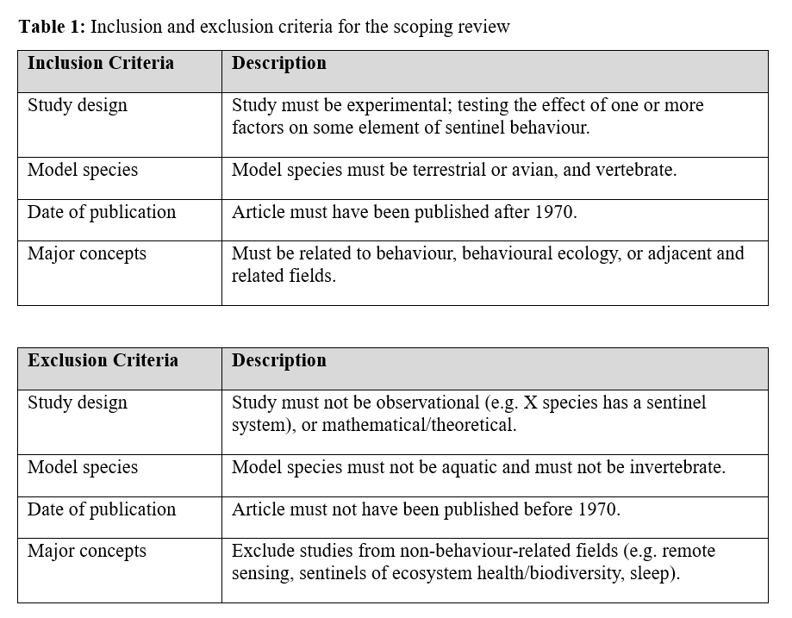
Methods
We searched Web of Sciences on Nov. 1st, 2022
- “Sentinel AND Behavio*” as keywords
- Filtered by major concepts
Notes:
Remove table, bullet point and condense slide 11 and 12
Keep the important things, remove anything else
Leave breadcrumbs for easy questions

Slide 12
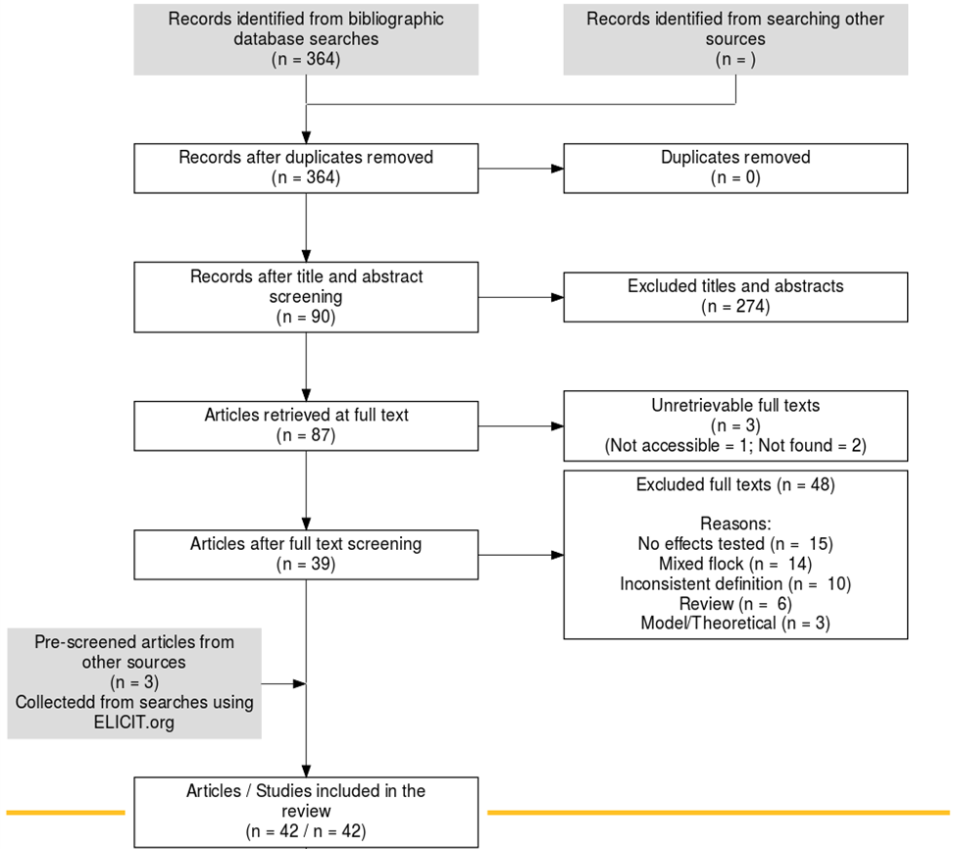
Search Results
Search string returned 364 records.
After screening, we retained 42 studies that fit our inclusion criteria.
Notes:
Very loosely say you *followed* the protocol for a scoping review -> ROSES

Slide 13
Trends observed
The effects of several intrinsic and extrinsic factors were common in both mammalian and avian species, including:
Intrinsic factors such as sex, body mass, and satiation
Extrinsic factors such as dominance, group size, and risk
Many intrinsic and extrinsic factors are energy-related.
An interaction between sex and dominance was often reported.
Notes:
Talk more about the implications of intrinsic and extrinsic factors
PICTURES!
Colour!

Slide 14




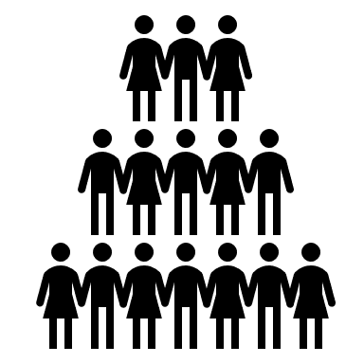

Energy-related factors
Sex: >
Body mass: >
Satiation: >
Group size: <
Sentinel present
Sentinel Absent
Lost foraging opportunity
↑ Risk
Earlier threat detection
Notes:
Use figures from literature to prove point
Table & use arrows

Slide 15

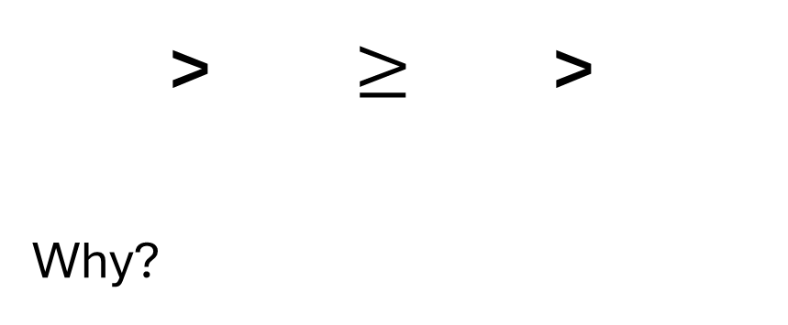
Dominance
Sentinel present
> $≥$ >
Why?
Sentinel Absent
Lost foraging opportunity
Could be energy-related but also be a result of different benefits provided by the behaviour
↑ Risk
Earlier threat detection
Notes:
Use figures from literature to prove point

Slide 16
Risk
The greater the risk, the greater the incentive to be a sentinel.
e.g. The presence of young or predators results in increased sentinel efforts from adult individuals.
Sentinel present
Sentinel Absent
Lost foraging opportunity
↑ Risk
Earlier threat detection
Surprisingly, the presence of outgroup rivals also increased sentinel efforts…
Notes:
Use figures from literature to prove point

Slide 17
Non-antipredator benefits
The sentinel’s perch provides good visibility over a large area.
This could provide non-antipredator benefits to certain individuals:
Territory defense
Mate guarding
Sentinel present
Sentinel Absent
Lost foraging opportunity
↑ Risk
Earlier threat detection
Notes:
Use figures from literature to prove point

Slide 18
Chapter 2 - Conclusions
Both intrinsic and extrinsic factors could have great effects on sentinel decision-making:
Energetic availability ↑ = ↑ Sentinel behaviour
Risk ↑ = ↑ Sentinel behaviour
Habitat can affect these factors, in turn affecting sentinel behaviour (e.g. Urban vs Natural environments).
Notes:
Sent only appears in certain situations -> habitat
picture

Slide 19
Chapter 3: Heads Up! Social Vigilance Behaviour in American Crows

Slide 20
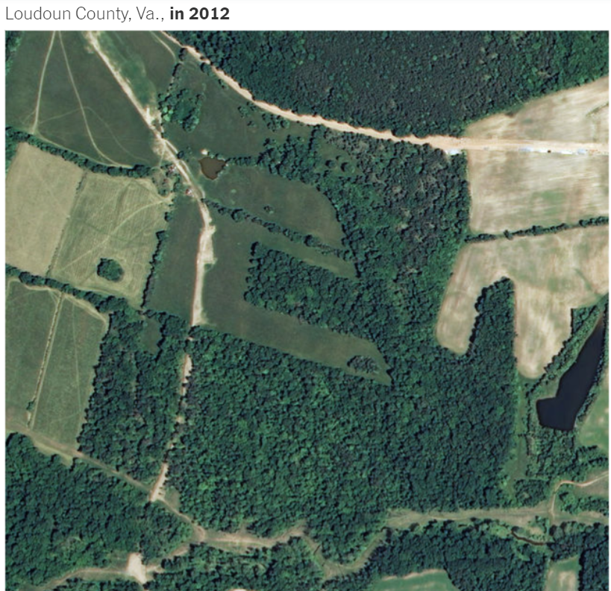
Urbanization
The shift in human population from rural to urban areas
NY Times, 2019
Notes:
~55% of world population currently concentrated in urban areas, with the UN projecting that number to climb to 68% by 2050.
Get a better image or polish it up

Slide 21
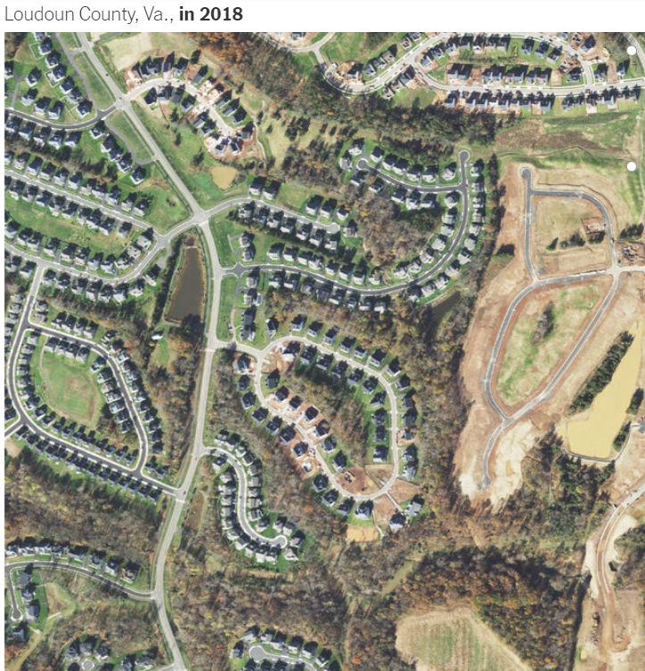
Urbanization
Leads to changes in the environment:
↓ Lines of sight
↑ Human-animal interactions
↓ Green spaces
NY Times, 2019
Notes:
~55% of world population currently concentrated in urban areas, with the UN projecting that number to climb to 68% by 2050.
Get a better image or polish it up

Slide 22
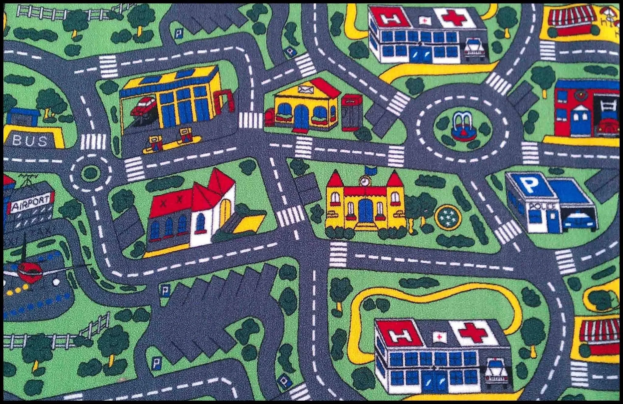
Urbanization
Urban areas are not uniform!
Has negative effects on many species; associated with the global loss of biodiversity
Kowarik I. 2011
Notes:
Humor hospital

Slide 23
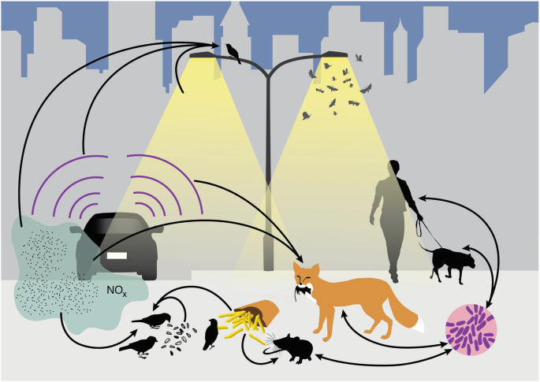
Can species be successful in cities?
Will depend on species’ traits
Advantageous traits:
Adaptability
A generalist nature
An omnivorous diet
Intelligence
Isaksson, C. (2018)
Patankar S et al. 2021
Notes:
Don’t dillydally

Slide 24
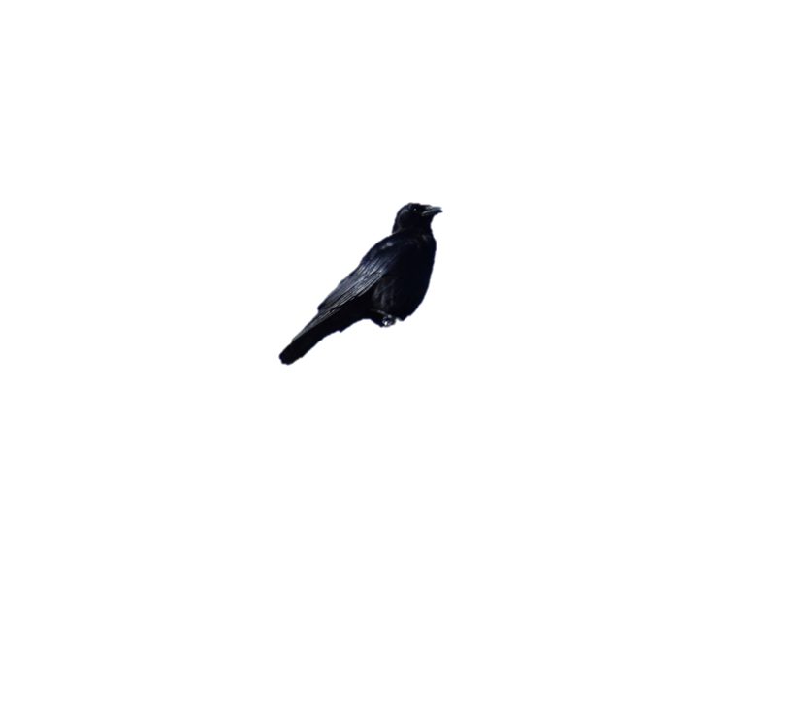
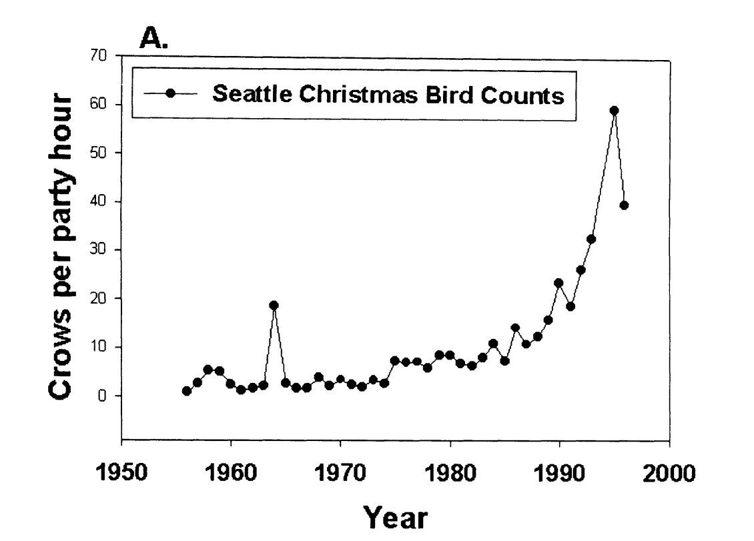
American crows in urban areas
How could the use of sentinel behaviour contribute to the success of American crows in urban areas?
Crows spotted per hour
American crow population increasing in urban areas over the last 5 decades
Marzluff et al.(2001)
Notes:
Breadcrumbs! <- WNV
Why care about crows

Slide 25
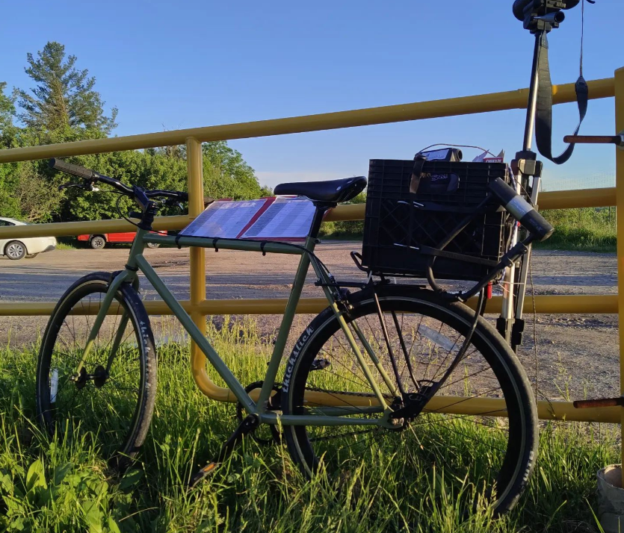
Methods
Testing sites were selected through a community science initiative: Crowkémon Go
Foraging bouts were video recorded from a distance and analyzed at a later date
Notes:
Armed with friends, cameras and bicycles, we bravely went out at 6am to chase crows!
Remove bait
Add images to explain generalized environment.
Bring the map back

Slide 26
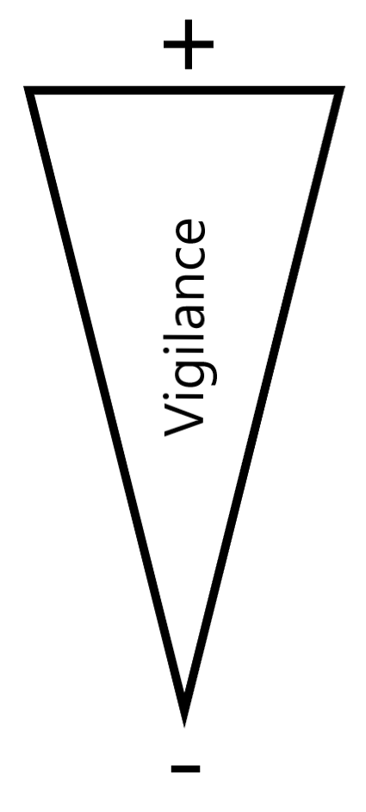

Methods
Alert
Moving
Foraging
Notes:
Can’t tell what the crow is looking at when moving (verbal)

Slide 27
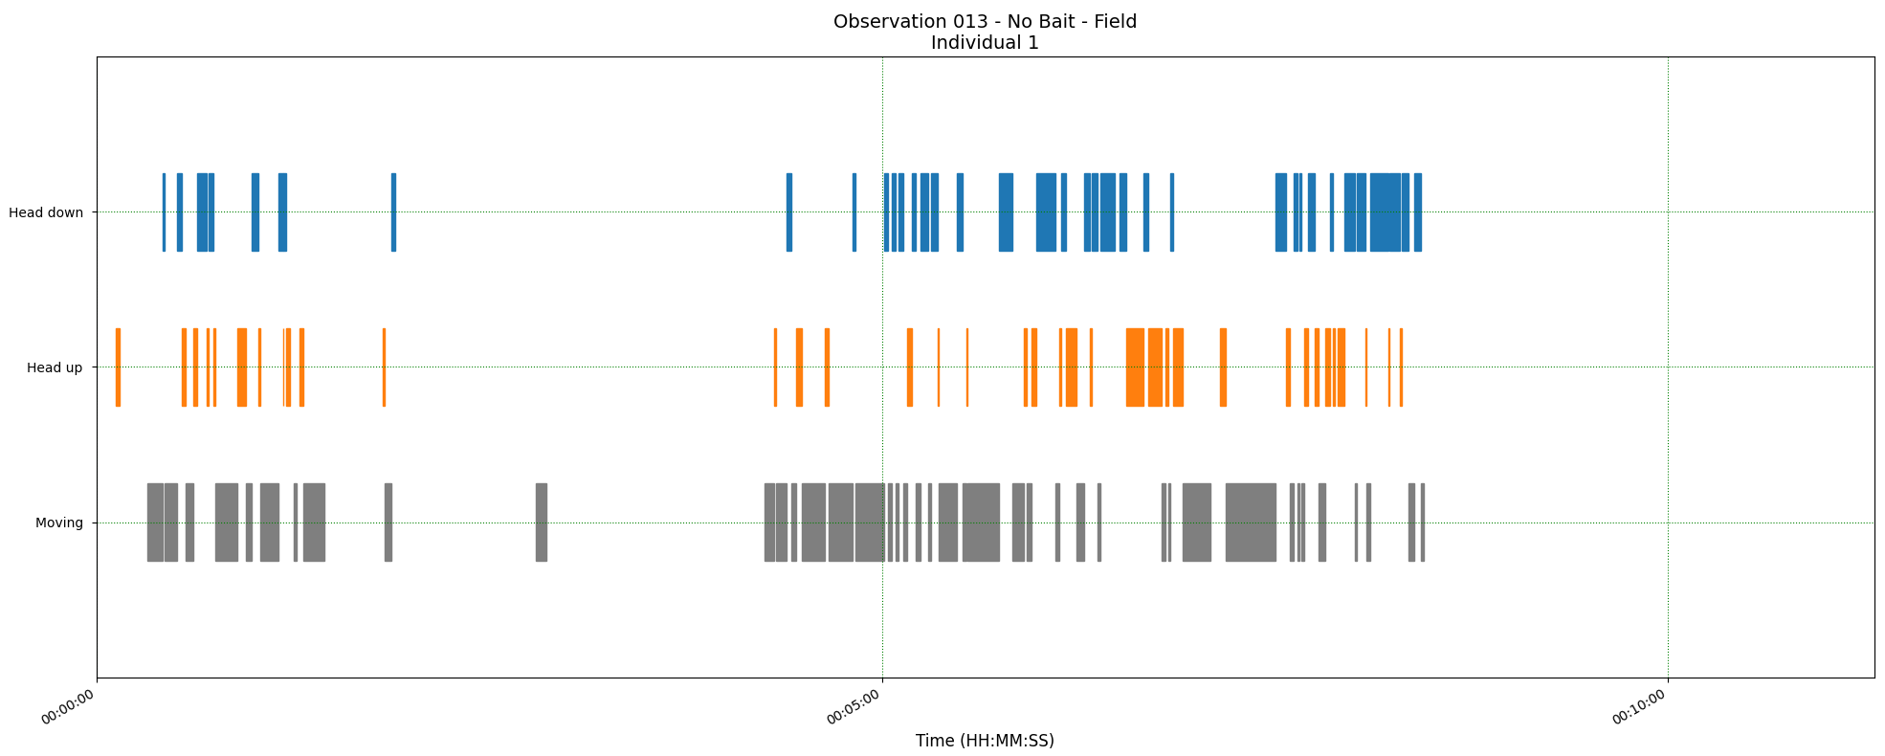
Methods
Two main measurements:
The proportion of ‘foraging time’ allocated to each behavior
Duration of bouts → each instance of a behaviour
Foraging
Alert
Moving
Time
Notes:
***Briefly explain & put arrows to show what each measurement is ***
**DO NOT MENTION BORIS!!!**
Explain the measurements explicitly.
Use this blue throughout

Slide 28
Research questions
 | Generalized Environment | Sentinel Presence
Allocation of time to behaviors in foragers | In green areas Foraging ↑ Alert ↓ | With a sentinel present Foraging ↑ Alert ↓
Duration of behavioral instances | In green areas Foraging ↑ Alert ↓ | With a sentinel present Foraging ↑ Alert ↓
Notes:
Remove right side, focus only on G. Env.
Be quick about it, no need to repeat, consider having the table reappear between results slides.

Slide 29
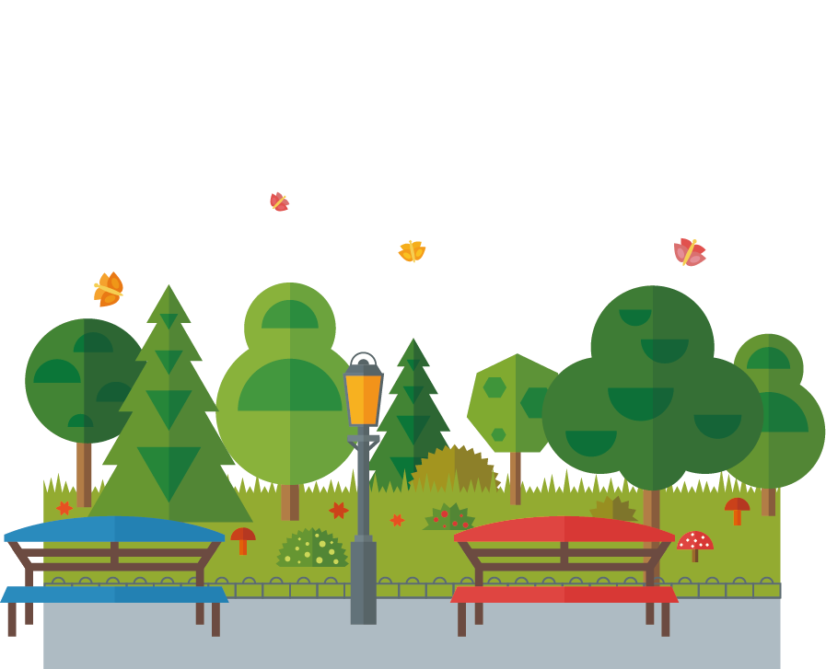

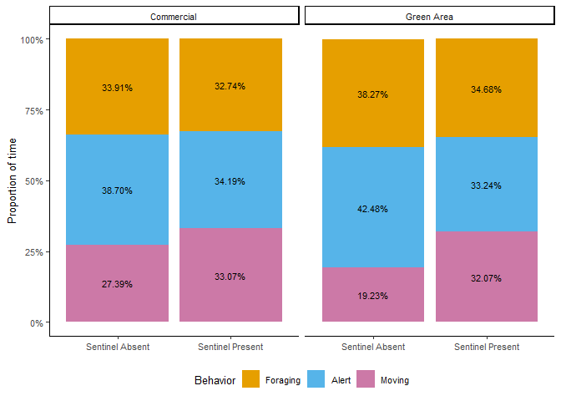

Proportion of time
Contrary to my predictions, there were no significant effects!
Proportion of foraging time
Notes:
Explain graph, then bring up the data
Put results in titles

Slide 30
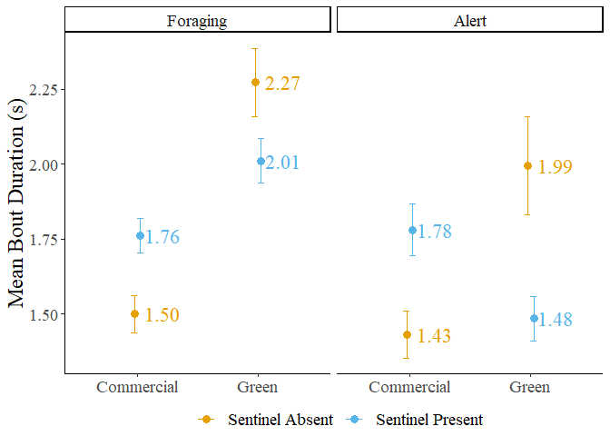
Bout duration
Sentinel presence did not significantly affect the duration of bouts.
Bouts of foraging behaviour were significantly longer in green areas.
No significant effects on bouts of alert behaviour.
Notes:
Redo the graph because of Lex’s OCD ☺
Font and colour
Predictions!

Slide 31
Bout duration
Significant interaction between sentinel presence and generalized environment on both foraging and alert behaviours.
Notes:
Take it piece by piece, step by step

Slide 32
Generalized environment
Food in green areas can take longer to forage on
Vegetation might obscure food – Time to find food ↑
Prey might use vegetation to escape – Time to catch food ↑
Comparatively, foraging in commercial areas could be easier
Impermeable surfaces ↑ – Time to find/catch food ↓
Anthropogenic resources ↑ – Time to find/catch food ↓

Slide 33
Generalized environment
This could explain the shift in preference towards anthropogenic resources in urbanized species.
However, foraging on urban resources could be unhealthy
Caloric content ↑ but nutritional value ↓
Lower quality but easily accessible
Natural food sources in green areas – Worth the risk?
Notes:
Pkug KMGs work

Slide 34
Generalized environment
The type and frequency of threats differ between the two environments:
Commercial areas – Vehicles, pedestrians, pets
Green areas – Pedestrians, pets, raptors
Green areas are also typically quieter and have longer sightlines, potentially making sentinel behaviour more effective than in commercial areas.

Slide 35

Sentinel presence
Benefits from sentinel coverage could depend on foraging environment.
Foragers could also be foraging in a ‘riskier’ but more efficient manner in the presence of a sentinel.
More space between individuals – Risk ↑
Foraging over a wider area – Foraging Efficiency ↑

Slide 36
Chapter 3 - Conclusions
 | Generalized Environment | Sentinel Presence
Allocation of time to behaviors in foragers | In green areas Foraging ↑ Alert ↓ | With a sentinel present Foraging ↑ Alert ↓
Duration of behavioral instances | In green areas Foraging ↑ Alert ↓ | With a sentinel present Foraging ↑ Alert ↓
No effect
No effect
In green areas
Foraging ↑
Significant interaction
Notes:
Remove right side, focus only on G. Env.
Be quick about it, no need to repeat, consider having the table reappear between results slides.

Slide 37
Sentinel behaviour and urban environments
Sentinel decision-making affected mostly by energy- and risk-related factors.
The behaviour of foragers was significantly affected by foraging environment and its interaction with sentinel presence.
Urbanization can potentially have effects on the propensity of individuals to perform sentinel behaviour.

Slide 38
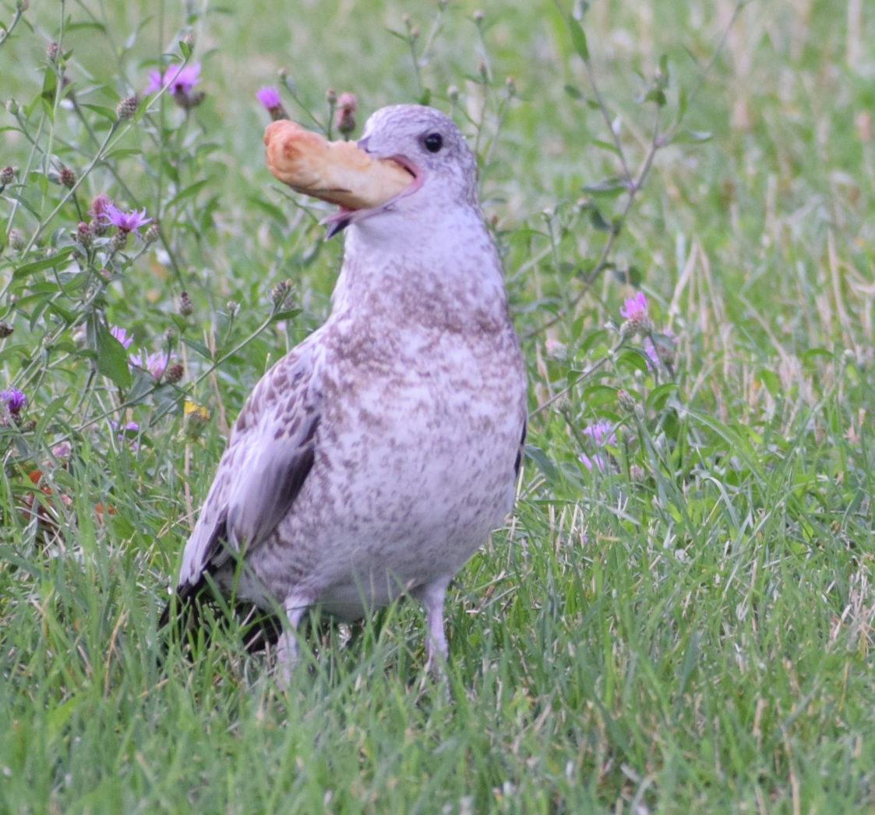
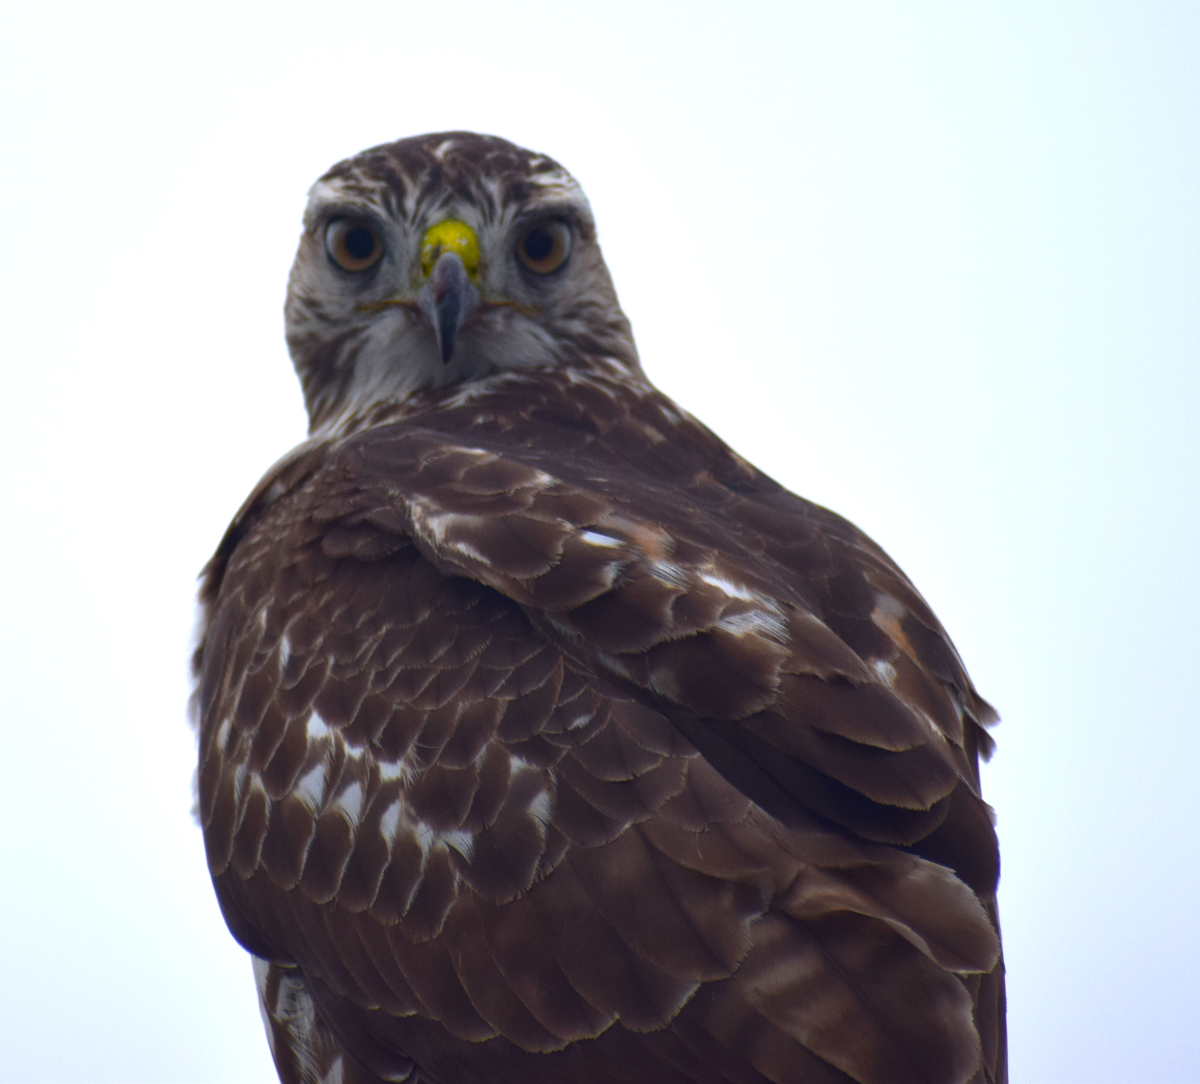
Sentinel behaviour and urban environments
Anthropogenic foods
Urban predators
Human interaction
Future research is required to build upon my findings

Slide 39
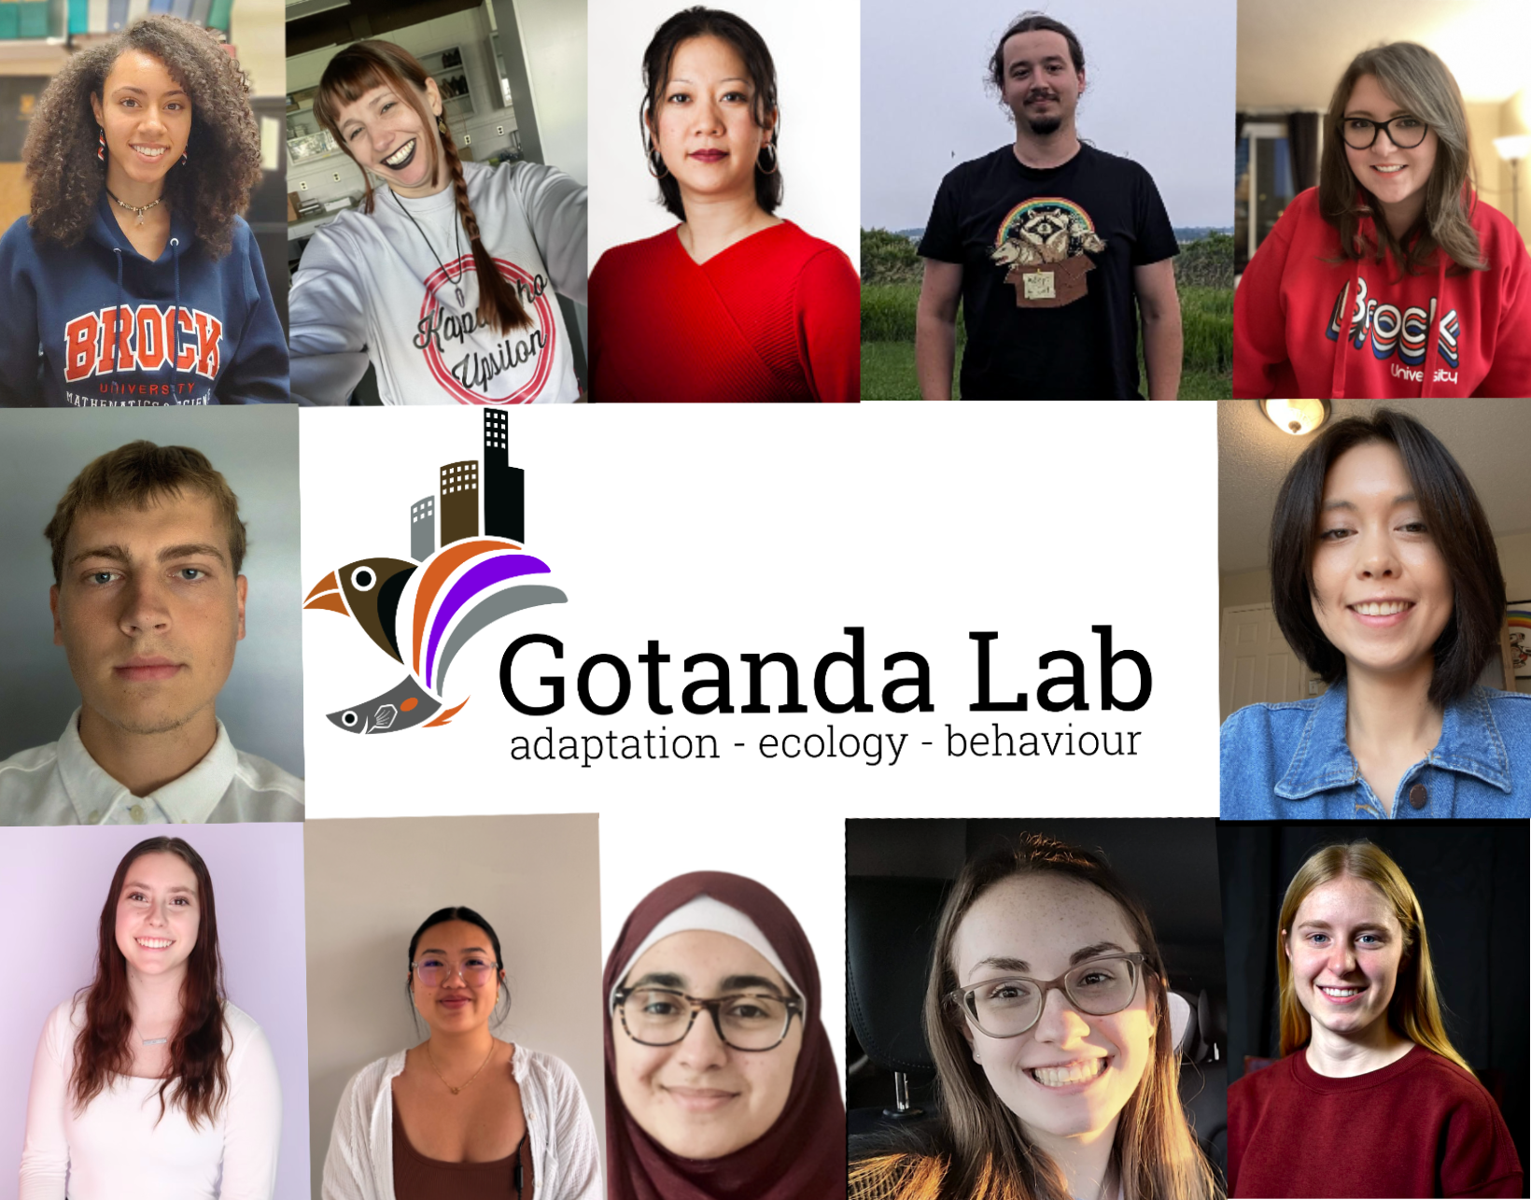
Acknowledgements
My supervisors: Dr. Kiyoko Gotanda, Dr. Liette Vasseur, Dr. Anne Clark
The Gotanda Lab
My family and friends
Notes:
Funded by Brock, no need to mention explicitly. Thank funding sources at a defense (which this isn’t)

Slide 40
Questions?

